Slide 1




No Malaria
Malaria

Slide 2

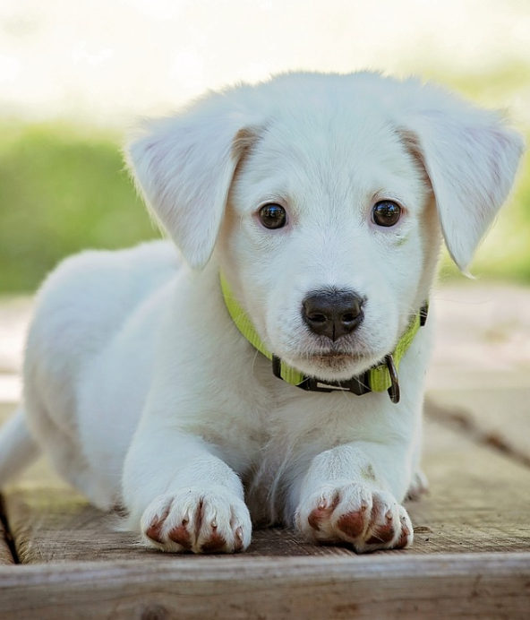

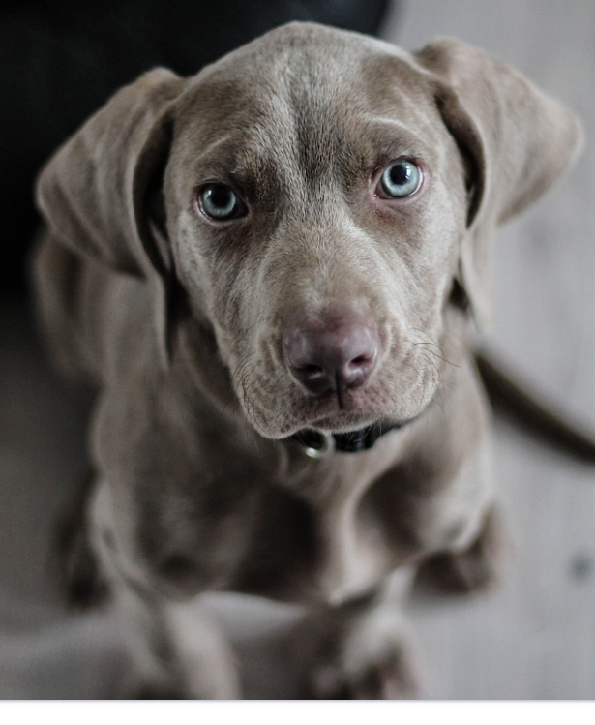
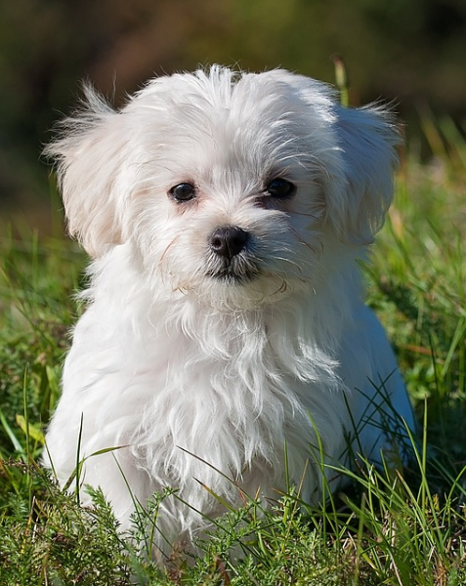

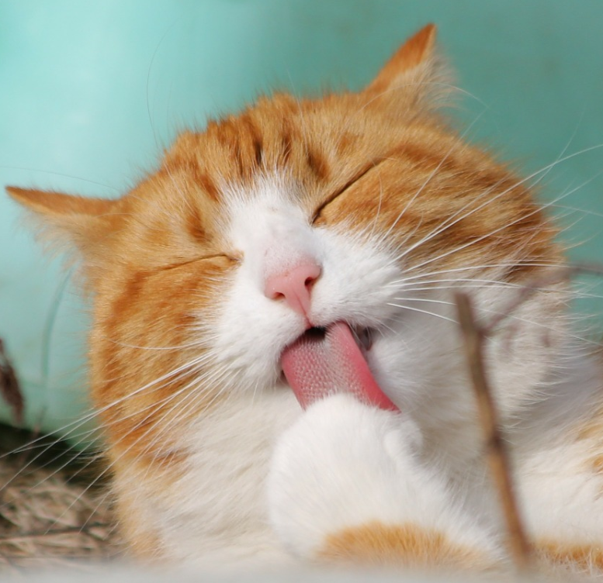
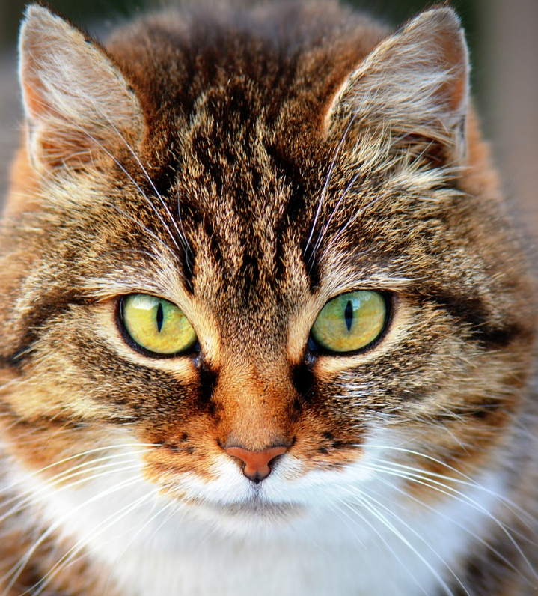
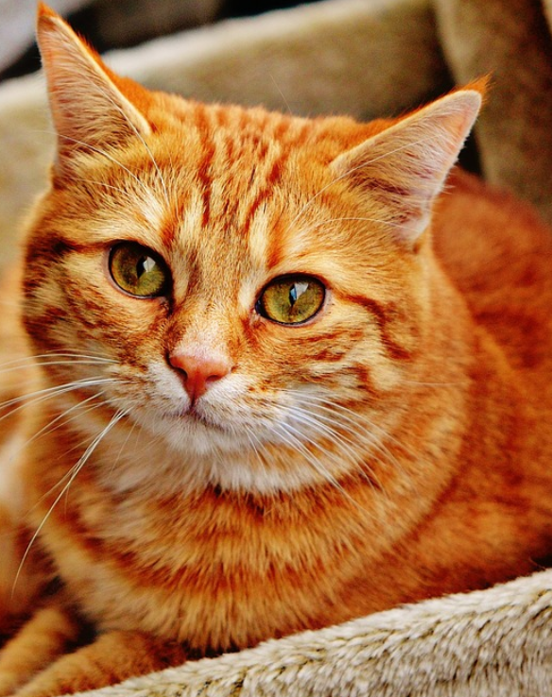

Real: dog
Pred: dog
Real: dog
Pred: dog
Real: dog
Pred: dog
Real: dog
Pred: dog
Real: dog
Pred: cat
Real: cat
Pred: cat
Real: cat
Pred: cat
Real: cat
Pred: cat
Real: cat
Pred: cat
Real: cat
Pred: cat

Slide 3
Predicted
False
True
Real: No Malaria Pred: No Malaria
Real: No Malaria Pred: Malaria
False
Actual
Real: Malaria Pred: No Malaria
Real: Malaria Pred: Malaria
True

